Slide 1
Automated Stock/level Monitoring
25 Apr 2022

Slide 2
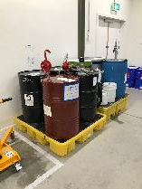
Automated stock/level monitoring
From Sheffield Workshop 12th January
 |  | Opportunity H = good | Feasibility H = hard | Decision
Assisted inbound goods validation | Broad problem, multiple perspectives, potential overlap with SAP indirect procurement project Q2 2022 | x | x | Should be done in core systems + changes to working practice / business processes
Maintenance management | Manual systems of maintenance planning, multiple inputs, definite opportunity to improve to easier and better process | 27 | 13 | Revisit with input from maintenance team
Assisted replenishment of line-side consumables / supplies | Manual checking and ordering, no monitoring or analysis, risk of running out / having too much | 17 | 8 | Chosen solution area

Slide 3
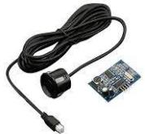
Automated stock/level monitoring
 | JSN-SR04T
Type | Ultrasonic
Range | 20cm-600cm
Accuracy | +-1cm
Waterproof | IP67
Voltage | 3-5.5 VDC
Cost | GBP 14
Additional board | Yes
Dimension (approx.) | Sensor: 23.5 x 20 (mm) with 2.5 m cable PCB: 41 x 28.5 (mm)

Slide 4
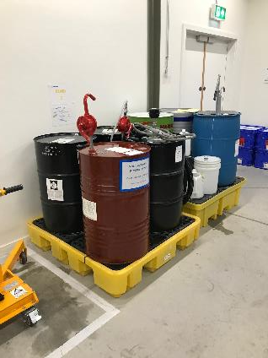
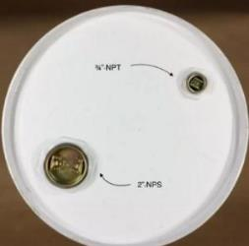
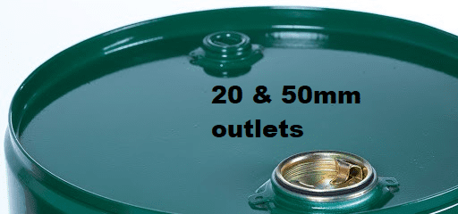
Automated stock/level monitoring
Standard drums have inside dimensions of 572 millimetres (22.5 in) diameter and 851 millimetres (33.5 in) height.
Large opening: 2″ NPS (57-63 mm)
Small opening: 3/4″ NPT (27 mm)
Generalise:
Large opening: 50-63 mm (For pump)
Small opening: 20-27 mm
Height: 800 mm and above

Slide 5
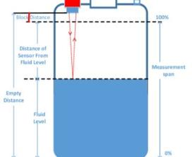
Sensing Methods
Contact type:
Ultrasonic sensor
For smaller opening (20-27 mm), only JSN-SR04T (23.5 mm) fits the dimension.

Slide 6
Automated stock/level monitoring
Choosing technologies:
Data collection
Ultrasonic sensor
State and data storage
Local and PI system
User interface
Webpage, Email
Service modules
Data Collection
State and Data Storage
User Interface

Slide 7
Features
Features/functions
User can get notification from sensor reading.
User can get notification from remaining stock trigger and expiry date based on inventory list database.
User can calculate usage over time (need more inputs from user).
Decoupled features/functions to minimise setting up time and human error.
Inventory list might be more than number of sensors.
Can be coupled depending user experience, will increase development complexity if high user-friendliness and flexibility are needed.

Slide 8
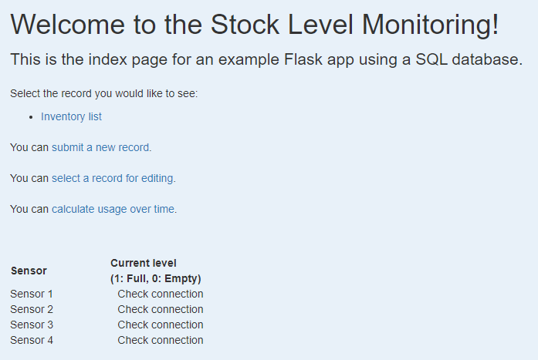
Index page
Hyperlink:
View inventory list
Submit a new record
Edit a record
Calculate usage over time
Showing the sensors measurement
(refresh the page to update the measurement)

Slide 9
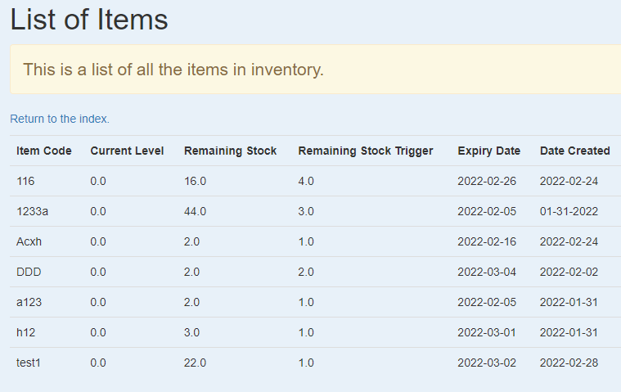
Inventory list
Hyperlink return to index page
Database of inventory list

Slide 10
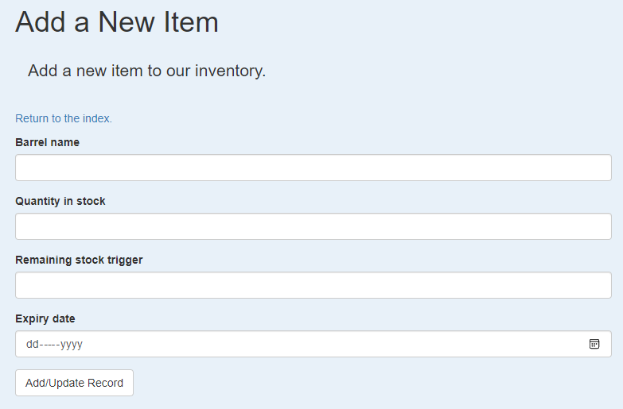
Submit a new record
Hyperlink return to index page
User can input relevant information for a record then add the record

Slide 11
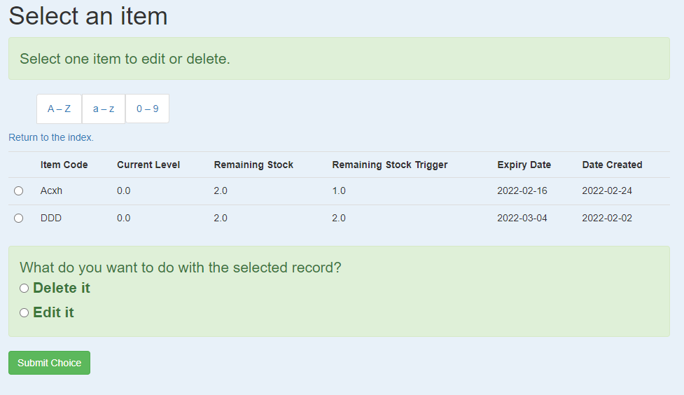
Select a record for editing
User can filter the result
Hyperlink return to index page
User can choose a record to perform operation
User can choose to edit or delete a record and submit the choice

Slide 12
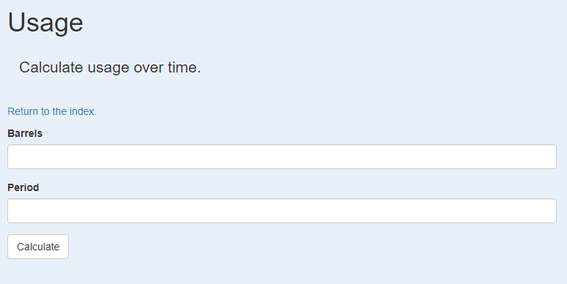
Calculate usage over time
Hyperlink return to index page
User enters relevant information and calculate
Note:
Need more inputs from users
How the user wants the information to be presented (location on webpage, in day/ week/ month/ specific period)?
The PI system can perform the calculation and analysis.

Slide 13
Notification email (Disabled)
Receive notification when
liquid level is running low.
remaining barrels running low.
approaching expiry date.
Email function is included but is not activated.
The email requires some settings (SMTP_server, SMTP_port, account and password). A general gmail account is used in the source codes.
The PI system can send out notification email.

Slide 14
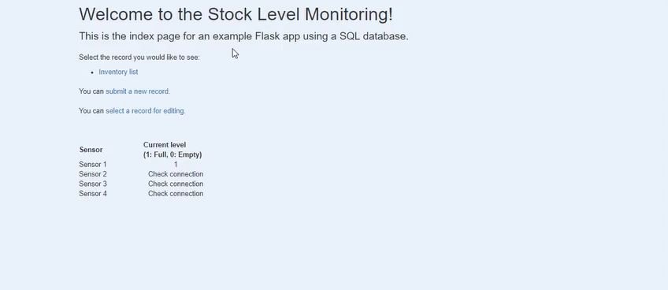
Automated stock/level monitoring (1st version)

Slide 15
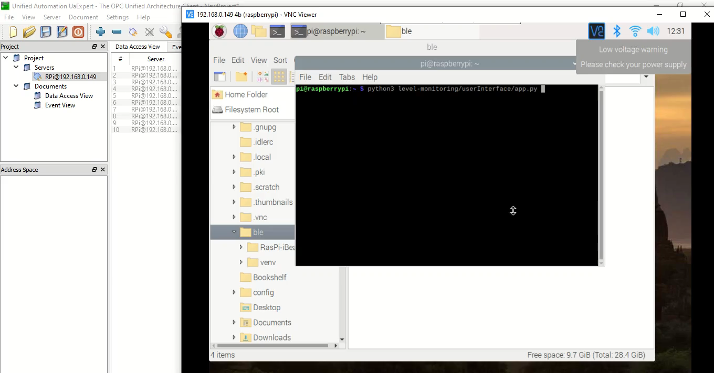
Automated stock/level monitoring (2nd version with OPC UA)

Slide 16
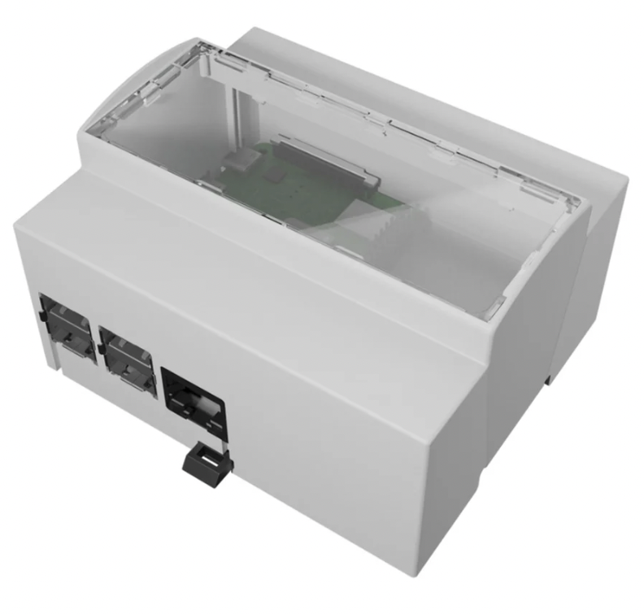
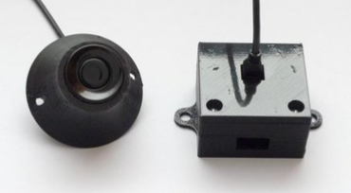
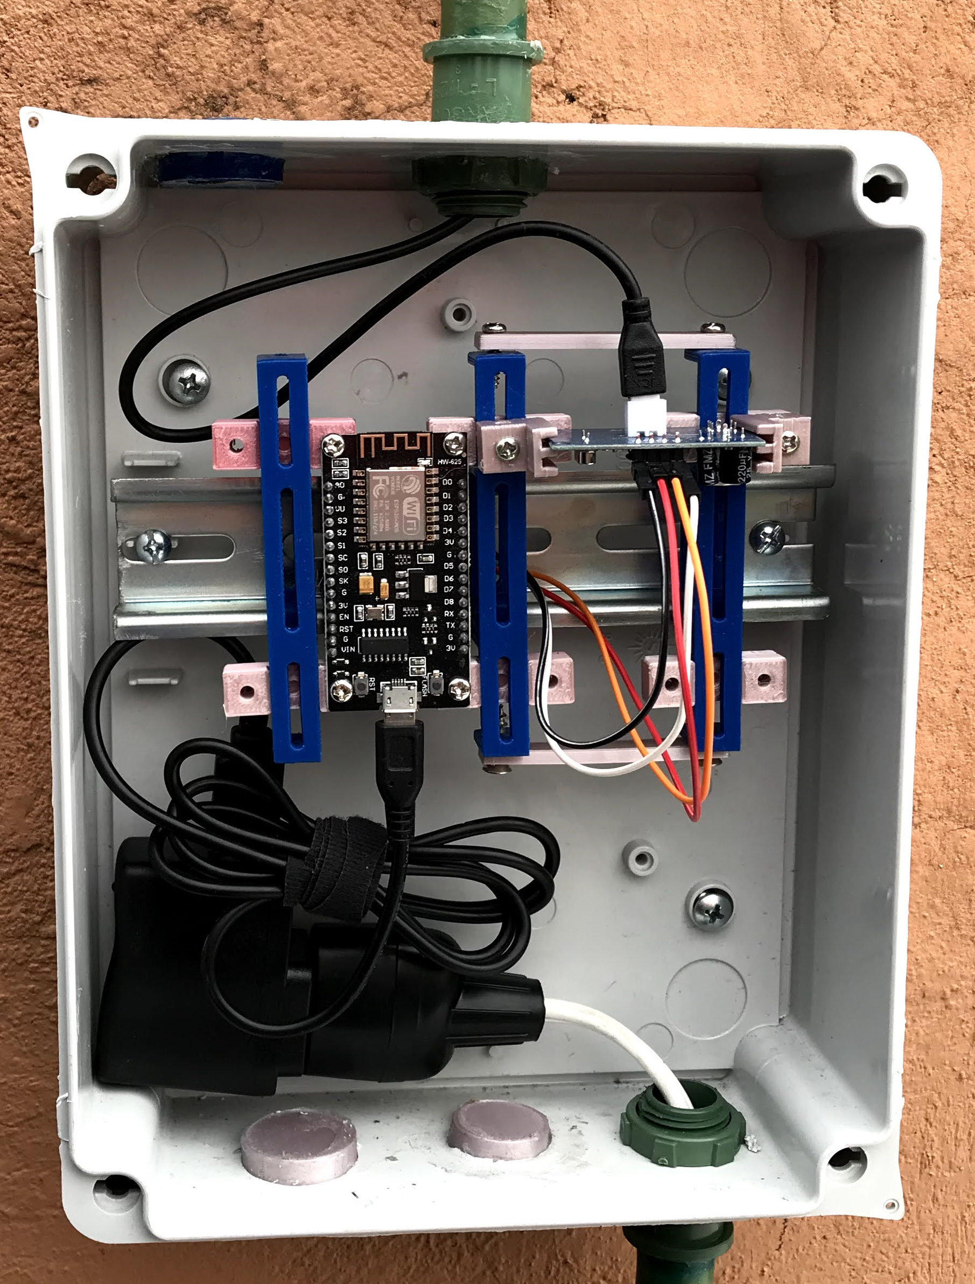
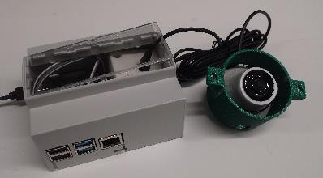
Safety
Sensor and driver circuit board are with 3D printed enclosure.
Sensor is waterproof (IP 67) with 2.5 meter cable.
Raspberry Pi is in a case.
Junction Box
Raspberry Pi (case)
Sensor driver circuit board (enclosure)
Logic level converter
Wires
Sensor (enclosure)

Slide 17
Source codes
https://github.com/jyl12/level-monitoring
Will send out 2 emails after this meeting (one try with this .zip embedded .pptx, another one follow up)

